Slide 1
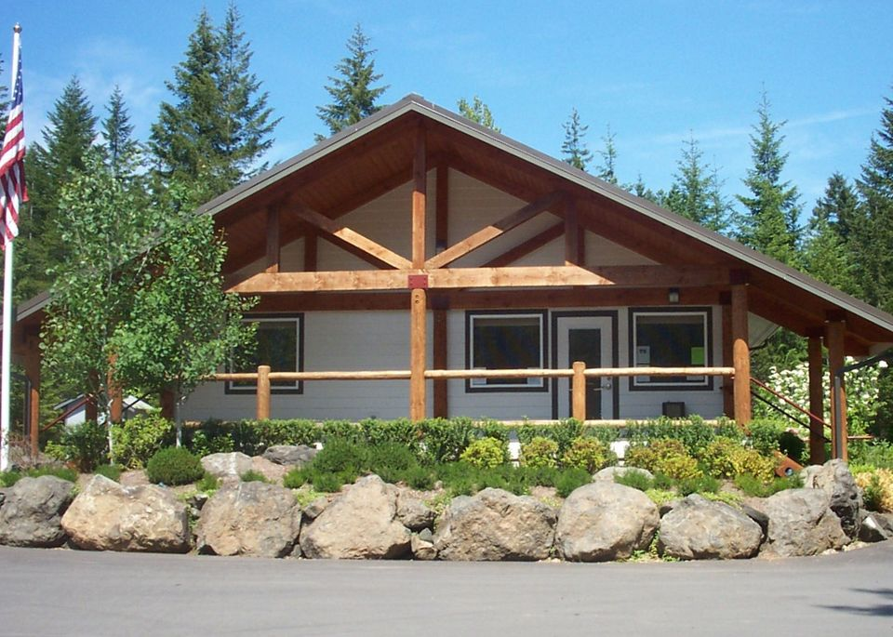
Lake Cushman Maintenance Co. 2023 Board Training
Prepared by the Robert W. Johnson P.L.L.C.
January 26, 2023

Slide 2
Governing Laws
Chapter 24.03A RCW Nonprofit Corporations
Chapter 64.38 RCW Homeowners Associations
Chapter 64.90 RCW Uniform Common Interest Communities Act

Slide 3
Chapter 24.03A RCW
Washington’s Nonprofit Corporations Act
LCMC formed June 30, 1966 Under Chapter 24.03 RCW
Chapter 24.03 RCW was repealed by the legislature in 2021 and replaced by Chapter 24.03A RCW
Governs formation and operation of LCMC as a Nonprofit Corporation

Slide 4
Chapter 24.03 RCW cont.
Formation and General Conditions
Governance
Members and Membership
Membership Meetings and Voting
Board of Directors
Meetings and Actions of the Board
Officers
Common provisions for Directors and Officers
Fundamental Transaction
Amendment of Articles or Bylaws
Dissolution/Disposition of Assets
Actions Involving Nonprofit Corporations

Slide 5
Chapter 64.38 RCW
Washington’s Homeowners Association Act.
“Homeowners' association” or “association” means a corporation, unincorporated association, or other legal entity, each member of which is an owner of residential real property located within the association's jurisdiction, as described in the governing documents, and by virtue of membership or ownership of property is obligated to pay real property taxes, insurance premiums, maintenance costs, or for improvement of real property other than that which is owned by the member. “Homeowners' association” does not mean an association created under chapter 64.32 or 64.34 RCW.

Slide 6
Chapter 64.38 RCW cont.
Special Provisions for a Nonprofit operating as a Homeowners Association:
Association Membership
Association Powers
Board of Directors (Standard of Care)
Bylaws
Association Meetings
Financial Records
Association Meetings
Budget Approval and Reserve Study
Voting in Person, Absentee Ballots and Proxies (2021

Slide 7
Chapter 64.90 RCW
Washington Uniform Common Interest Communities Act (2018)
To protect the public interest, RCW 64.90.095 and 64.90.525 supersede existing provisions of the governing documents of all plat communities and miscellaneous communities previously subject to chapter 64.38 RCW.
Only RCW 64.90.525, RCW 64.90.545 and RCW 64.90.095 apply
RCW 64.90.525: Budgets, Assessments and Special Assessments. Budgets and Assessment Approved unless rejected by a majority of Members.
RCW 64.90.545: Reserve Study
RCW 64.90.095: Election to be governed by Chapter 64.90 RCW.

Slide 8
Other Governing Documents
Covenants
Articles of Incorporation
By-Laws
Rules and Regulations

Slide 9
Hierarchy of Governance
Chapter 64.90 RCW (three that apply)
Chapter 64.38 RCW
Chapter 24.03A RCW (When mandatory)
Covenants
Article of Incorporation
By-laws
Rules and Regulations

Slide 10
Being a Board Member
(1) Except as provided in the association's governing documents or this chapter, the board of directors shall act in all instances on behalf of the association. In the performance of their duties, the officers and members of the board of directors shall exercise the degree of care and loyalty required of an officer or director of a corporation organized under chapter 24.03A RCW.
(RCW 64.38.025)

Slide 11
Standard of Care
RCW 24.03A.495
Standards of conduct for directors.
(1) Each director, when discharging the duties of a director, shall act:
(a) In good faith;
(b) With the care an ordinarily prudent person in a like position would exercise under similar circumstances; and
(c) In a manner the director reasonably believes to be in the best interests of the nonprofit corporation.
(2) In discharging board or committee duties a director shall disclose, or cause to be disclosed, to the other board or committee members information not already known by them but known by the director to be material to the discharge of their decision-making or oversight functions, except that disclosure is not required to the extent that the director reasonably believes that doing so would violate a duty imposed by law, a legally enforceable obligation of confidentiality, or a professional ethics rule.

Slide 12
Standard of Care cont.
(3) In discharging the duties of a director, a director may rely on information, opinions, reports, or statements, including financial statements or other financial data, if prepared or presented by:
(a) One or more officers, employees, or volunteers of the nonprofit corporation whom the director reasonably believes to be reliable and competent in the functions performed or the matters presented;
(b) Legal counsel, public accountants, or other persons retained by the corporation as to matters involving skills or expertise the director reasonably believes are matters:
(i) Within the particular person's professional or expert competence; or
(ii) As to which the particular person merits confidence; or
(c) A committee of the board of which the director is not a member, designated in accordance with provisions of the articles or bylaws, as to matters within its designated authority, if the director reasonably believes the committee merits confidence.

Slide 13
o Riss v. Angel, 131 Wash. 2d 612, 616, 934 P.2d 669, 673 (1997)
As to improvements, construction and alterations in Mercia Heights addition, the ... Mercia Corporation shall have the right to refuse to approve the design, finishing or painting of any construction or alteration which is not suitable or desirable in said addition for any reason, aesthetic or otherwise ... [considering] harmony with other dwellings ... the effect on outlook of adjoining or neighboring property and any and all other factors which in their opinion shall affect the desirability or suitability of such proposed structure, improvement or alterations.

Slide 14
Riss v. Angel cont.
A decision under a consent to construction covenant must be reasonable.
In examining whether rejection of a proposal is reasonable, courts have identified a number of factors which demonstrate unreasonable decision making. Among other things, courts have found decisions unreasonable where there was no evidence in the record as to external design of any other structures in the subdivision aside from the applicant's residence and the record showed merely conclusory statements of the chairman of an architectural control committee that the proposed residence was not harmonious with surrounding structures. Also unreasonable was the failure to take neighbors' views into consideration as required, evidenced in part by an architectural control committee's failure to even view the site when deliberating on approval of an applicant's proposed addition. Further, unreasonable rejection of a building plan was found where there were two modern houses in a predominantly traditional subdivision, the applicant's nontraditionally styled home was not detrimental to the neighborhood, and the grantor would have approved the plans but for objections of neighbors whose houses were not depreciated in value by the building of the house. Donoghue.

Slide 15
Riss v. Angel cont.
There is no evidence that the Board reasonably assessed the impact of Plaintiffs' proposed structure. Instead, the homeowners were presented with a misleading photo montage about the impact of Plaintiffs' plans. There is no evidence the Board visited the site, much less with a eye to neighbors' views or privacy. There is no evidence in the record that the Board made any objective comparisons with existing homes to compare size and height, though those were major reasons for rejecting the proposed plans. The trial court's finding that the Board president's photo montage was inaccurate and misleading is supported by the evidence. Its finding that another board member wrote a letter to homeowners inaccurately stating the height and size of the proposed structure is also supported by the evidence. While the height stated in this letter, a ridge height of 25 feet, was taken from structural plans, that height had nothing to do with the covenant restriction based upon measurement from the highest finished grade of the lot. These lobbying efforts by board members demonstrate less than a fair assessment of Plaintiffs' proposed structure.

Slide 16
Riss v. Angle cont.
Board Members owe a Fiduciary Duty to exercise ordinary care in performing their duties and to act reasonably and in good faith.
If Violated Liability: ”The appellant homeowners (petitioners) who participated in or ratified the decision to reject Plaintiffs' proposal shall be jointly and severally liable for damages and attorney fees”

Slide 17
Open Meetings
RCW 64.38.034
“All meetings of the board of directors shall be open for observation by all owners of record and their authorized agents.”
Compare to Washington’s Open Meetings Act Chapter 42.30 RCW.
Meeting is where an “Action” takes place.
RCW 42.300.020 “Action" means the transaction of the official business of a public agency by a governing body including but not limited to receipt of public testimony, deliberations, discussions, considerations, reviews, evaluations, and final actions. "Final action" means a collective positive or negative decision, or an actual vote by a majority of the members of a governing body when sitting as a body or entity, upon a motion, proposal, resolution, order, or ordinance.

Slide 18
Open Meetings cont.
Risky Areas if Quorum.
Email
Telephone Tree
Inadvertent meeting

Slide 19
Legislative Update

Slide 20
Chapter 24.03A
New in 2021 effective January 2022
1. Fiduciary Duties of Members: Members generally do not have fiduciary duties to the nonprofit.
2. Electronic Communications and Conferences: By default, electronic communication and email notices are allowed, however members, directors or officers who want to receive written notices can opt out. By default, members, directors, and officers can hold meetings fully or partially online by video conferencing, telephone, or other real time medium.
3, Persons under the age of 18 can now serve on the Board of Directors.
4. Officers. The current Act requires a president and at least one vice president, secretary, and treasurer. The New Act no longer requires a vice president.
5. Members’ Rights. The New Act provides members with certain rights such as: (a) access to records; (b) the right to vote for the election of directors; and (c) the right to vote on fundamental transactions, which include amendments to articles or bylaws, mergers, the sale of all or substantially all assets, domestication, conversion, or dissolution of a nonprofit.
6. Membership Organizations: The previous law governing membership nonprofits was incomplete and left many unanswered questions about the rights and duties of nonprofit members. The New Act adds a comprehensive set of provisions governing membership in nonprofit organizations. RCW 24.03A.315-.485.

Slide 21
Inspection of Record
RCW 24.03A.215
Inspection by members.
(1) A member of a nonprofit corporation may inspect and copy, during regular business hours at a reasonable location specified by the corporation, any of the records the corporation is required to maintain under RCW 24.03A.210(2), if the member delivers to the corporation an executed notice in the form of a record at least five business days before the date on which the member wishes to inspect and copy the records.
(2) Subject to the limitations set forth in subsections (3) and (4) of this section, a member of a nonprofit corporation may inspect and copy, during regular business hours at a reasonable location specified by the corporation, any of the following records of the corporation, if the member delivers to the corporation an executed notice in the form of a record at least five business days before the date on which the member wishes to inspect and copy the records:
(a) Excerpts from those minutes and records required to be maintained under RCW 24.03A.210(1);
(b) Accounting records of the corporation described in RCW 24.03A.210(3); and
(c) Subject to RCW 24.03A.240, the membership list described in RCW 24.03A.210(4).

Slide 22
Inspection of Reocords
(3) A nonprofit corporation may withhold from inspection under this section:
(a) Those portions of records that contain information protected by the attorney-client privilege or related work product;
(b) The address of any member who is known to the corporation to be a participant in the address confidentiality program described in chapter 40.24 RCW or any similar program established by law;
(c) Those portions of records, which, if disclosed, would be reasonably likely to result in harm to the corporation or a third party, such as disciplinary actions involving nondirector members, identities of job applicants, discussions of strategic acquisitions, records that are required to be kept confidential under obligations to a third party, etc.; or
(d) Any information that a nonprofit corporation is required to keep confidential under any other law.
(4) A member may inspect and copy the records described in subsection (2) of this section only if the:
(a) Member's demand is made in good faith and for a proper purpose;
(b) Member describes with reasonable particularity the purpose and the records the member desires to inspect;
(c) Member agrees in the form of a record to reasonable restrictions required by the board on the use or distribution of the records; and
(d) Records are directly connected with this purpose.
(5) The right of inspection granted by this section may not be abolished or limited by a nonprofit corporation's articles or bylaws.
(6) This section does not affect the:
(a) Right of a member to inspect records as part of discovery in connection with litigation; or
(b) Power of any court of competent jurisdiction, independently of this chapter, to compel the production of corporate records for examination.
[ 2021 c 176 § 1602.]

Slide 23
Compare RCW 64.38.045
(2) All records of the association, including the names and addresses of owners and other occupants of the lots, shall be available for examination by all owners, holders of mortgages on the lots, and their respective authorized agents on reasonable advance notice during normal working hours at the offices of the association or its managing agent. The association shall not release the unlisted telephone number of any owner. The association may impose and collect a reasonable charge for copies and any reasonable costs incurred by the association in providing access to records.

Slide 24
Other Changes to HOA Law
64.38.010 Electronic communication
64.38.035 Notice of Meeting 50 days instead of 60
64.38 new Electronic Notice of Meetings
64.38 new Voting and Proxies
64.38.062 Prohibit Charging Stations Restrictions
64.38.100 Liens for unpaid assessments--Notice of delinquency (Effective January 1, 2024)

Slide 25
Thank you! Questions?

